Slide 1
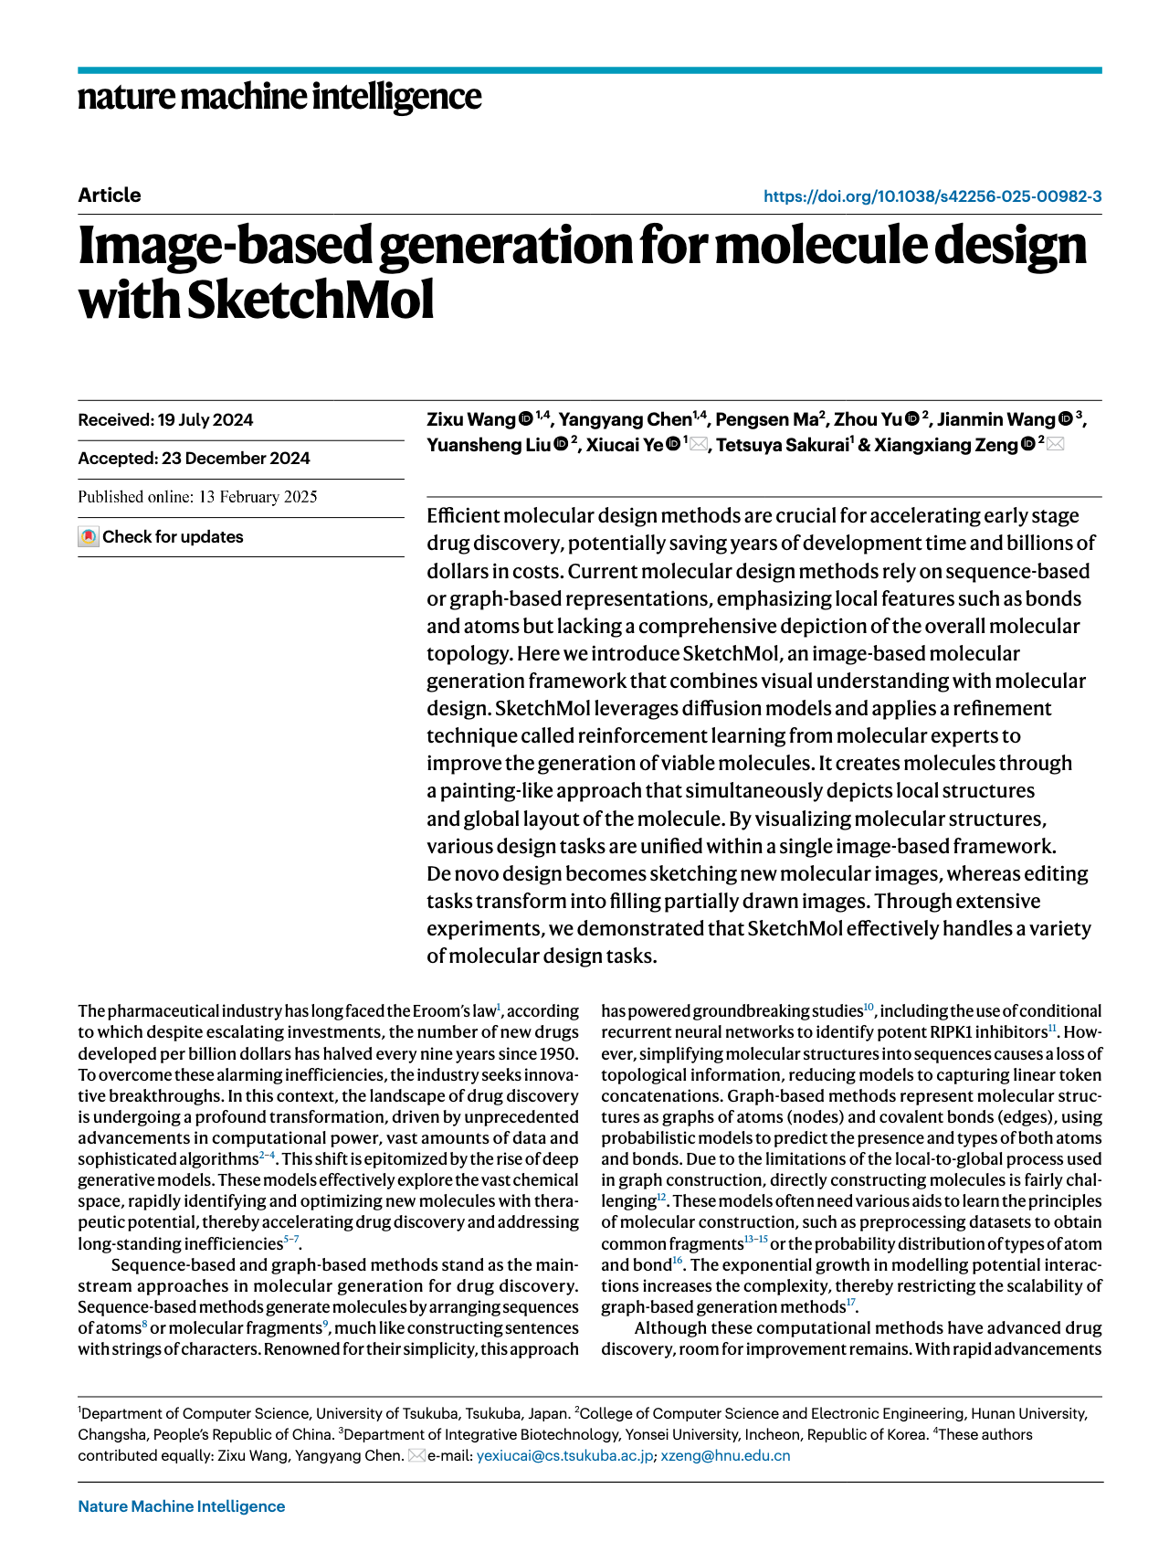
SketchMol at a Glance
Existing Representations
Research Background
Eroom's law
We need better efficiency in molecule design
Sequence: SMILES Graph structure
Both have limitations
Roadmap
• Drug discovery faces persistent efficiency challenges, motivating better generative design methods
• SketchMol represents molecules as images rather than only sequences or graphs
• The framework unifies de novo design and molecular editing through a visual generation workflow
• Research focus: conceptual understanding, methodology, and evidence from the paper
Notes:
Today I will introduce a paper called SketchMol: image-based generation for molecule design.
First, let’s look at the background.
In drug discovery, there is a well-known problem called Eroom’s law.
It means, in molecule design, the cost is increasing, the time is increasing but efficiency is not improving
So, we need better ways to design molecules faster and better.
Next, let’s look at existing methods.
There are two main ways to represent molecules:
- sequence, like SMILES
- graph structure
Both are useful, but both have limitations.
For example:
sequence loses structure information
graph can be complex and hard to model
So this leads to the main idea of this paper:
Instead of using only sequences or graphs, SketchMol see molecules as images.
This allows the model to see both local details and the whole structure at the same time.
Now let’s look at the roadmap of this talk.
First, we explain the problem and motivation.
Then, we introduce the main idea of SketchMol.
After that, we go through the method and experiments.
Finally, we discuss what we can learn from this paper.

Slide 2
Why Move Beyond Sequences and Graphs?
Representation Shift
Molecular generation needs a representation that captures both chemically meaningful local structure and the overall organization of the molecule.
A compact comparison of the main molecular
representation choices.
• Representation | What it captures well | Main limitation
• Sequence | Simple serialization and easy use with language-style models | Can obscure global topology and long-range structural relationships
• Graph | Explicit atom-bond connectivity and chemical structure | Construction, manipulation, and scaling can be difficult for generation pipelines
• Image | Local visual detail and whole-structure layout in one space | Requires learning a valid visual-to-chemical correspondence
What the generation task really demands
• Molecular design is not only about correct atoms and bonds
• It also requires a coherent global arrangement so the whole structure makes sense as one object.
Why image-based modeling is plausible
Image generation models are designed to capture fine local patterns while maintaining global spatial consistency.
That makes them a natural candidate for molecule generation when we want to model detailed substructures and overall molecular organization together.
Notes:
Now, let’s look at the next question: Why do we need to move beyond sequences and graphs?
First, molecule generation needs a better representation.
It should capture:
local chemical structure and the overall structure at the same time.
So what do we really need?
We need two things:
correct local atoms and bonds and a clear global structure
The whole molecule should make sense as one object.
This is why image-based modeling is useful.
Images can show:
local details and global layout at the same time.
So the model can learn both together.
On the right side, we compare three methods:
Sequence: simple, but weak on global structure
Graph: accurate, but complex
Image: can capture both local and global
So the underlying hypothesis of this paper is:
image-based representation can better balance detail and overall structure.
问题答疑： What is the difference between graph and image?
Graph only care about the connection between atoms, it could be a dictionary for example:
{
C: H
O: X }

Slide 3
The Core Idea: Molecules as Visual Objects
The paper’s key shift is to treat a molecule not only as a symbolic string or graph, but as a visual object that can be created and edited directly in image space. In one view, a molecular image can expose atom types, bond patterns, and overall spatial arrangement, making the design process easier to align with human intuition.
Old interface: Symbolic encoding is powerful, but it separates representation from how people naturally sketch and revise structures.；New interface: An image becomes a single workspace for generation, modification, and inspection.
See the whole molecule at once
A molecular image can display atom identities, bond connections, and global shape in one integrated view instead of splitting these cues across separate symbolic forms.
Generate de novo by drawing
Creating a new molecule becomes analogous to drawing on a blank canvas: the model generates a complete structure directly in visual form.
Notes:
In traditional methods, we use sequences or graphs.
But here, we treat a molecule as something we can see, draw, and edit.
First, what is the main advantage?
A molecular image can show everything at once:
- atom types
- bonds
and the overall structure
So we can see the whole molecule in one view.
Next, think about the difference in interface.
Before, we use symbols, Now, we use images. So one image becomes a workspace for generation and editing.
This also makes generation easier to understand.
Instead of building step by step, we can draw a molecule on a blank canvas.
This feels more natural.
And for editing,
we can select a region, and let the model fill it in.
So modification becomes simple and direct.

Slide 4
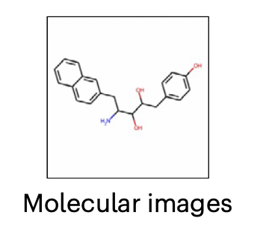
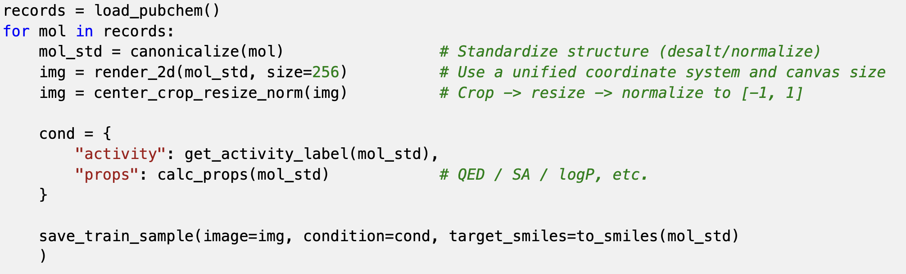
SketchMol Architecture Overview (Training Stage)
Data Preparation • Obtain molecular structures from molecular datasets (such as PubChem);
• Render into normalized 2D molecular images;
• Perform necessary preprocessing (cropping, scaling, normalization, etc.);
• Prepare labels for conditional generation (such as activity, property ranges, or target constraints).
Notes:
Now, let’s look at the architecture, starting from the training stage.
First, we prepare the data.
We take molecules from datasets, for example, PubChem. Then, we convert each molecule into a 2D image.
Next, we preprocess the images.
We do things like: cropping, resizing , normalization
So all images have the same format.
After that, we prepare labels for training. These labels can include:
activity
molecular properties
For example: QED, SA, logP.
So each training sample has:
an image
some condition labels
and the original molecule (SMILES)

Slide 5
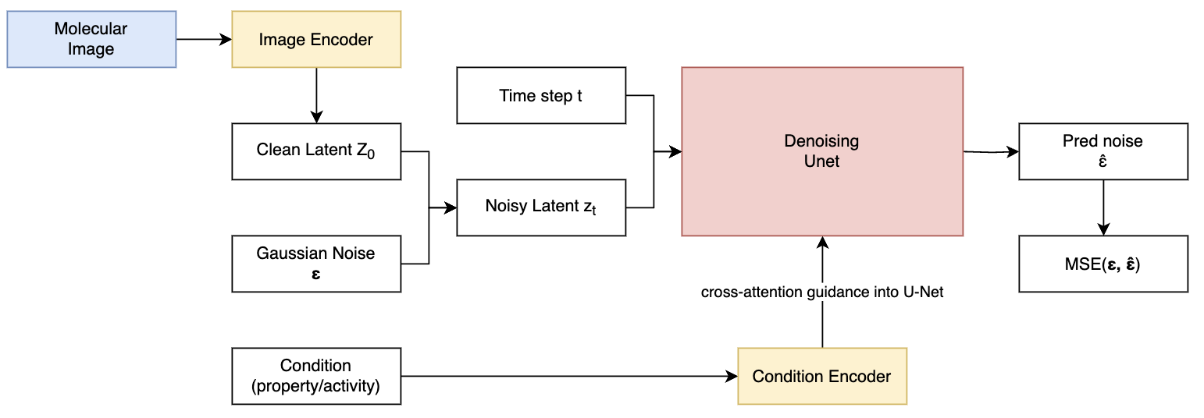
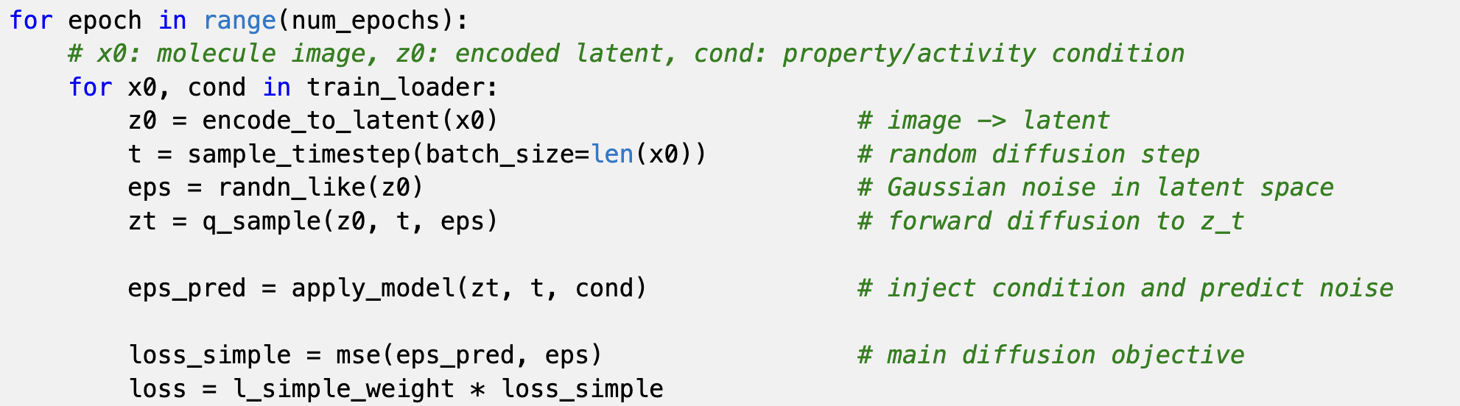
Training Stage
The main task is to "predict the added noise," and once learned, it can perform reverse denoising during sampling;
Notes:
Now, let’s look at the training process.
The main idea is very simple: the model learns to predict noise.
First, we take a clean molecular image.
Then we encode it into a latent space.
You can think of this as a compressed version of the image.
Next, we add noise to it.
We add Gaussian noise with respect to t
We use the denoising U-Net.
It takes three inputs:
the noisy image
the time step
and the condition (like properties)
Then the model outputs: the predicted noise.
During training,
we compare: the real noise and the predicted noise using MSE loss.
So the goal is simple:
make the predicted noise as close as possible to the real noise.
After training, since we can predict the noise we add, the model is able to remove noise to get a clean molecule image.

Slide 6
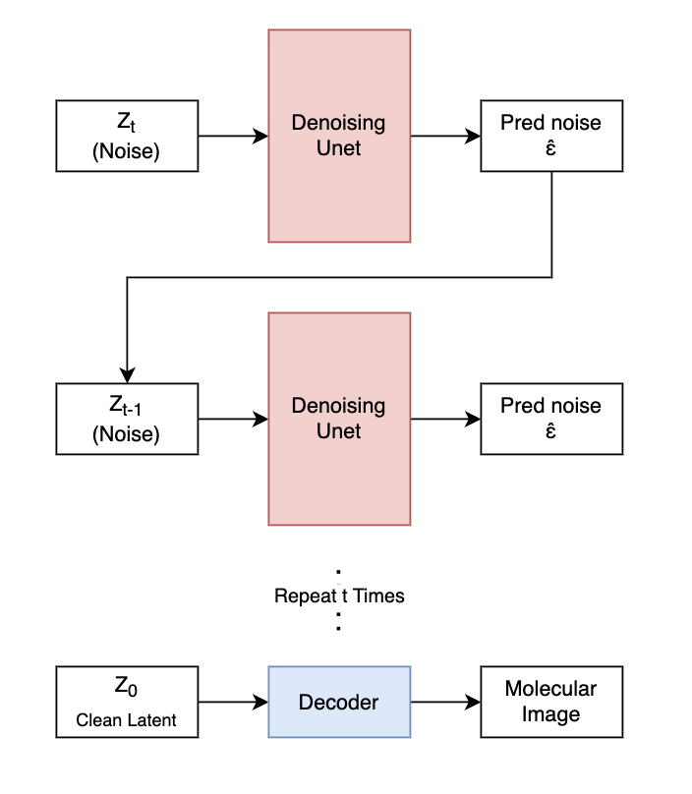
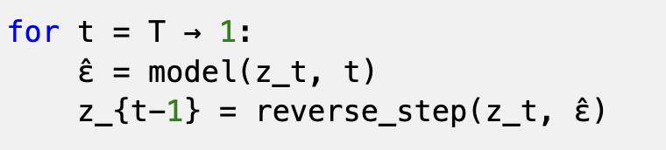
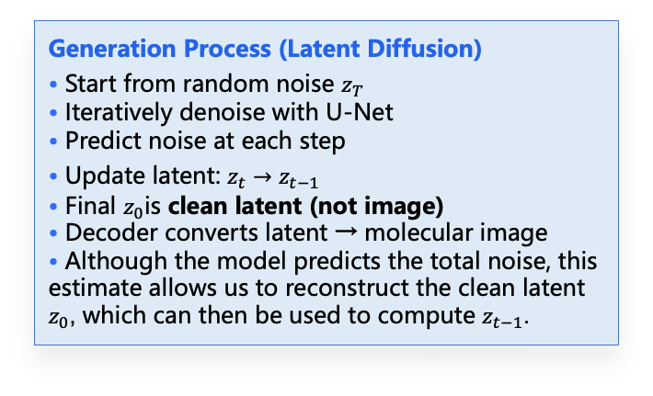
SketchMol Architecture Overview (Generation)
Generation Process (Latent Diffusion)
• Start from random noise $z_{T}$
• Iteratively denoise with U-Net
• Predict noise at each step
• Update latent: $z_{t}→z_{t−1}$
• Final $z_{0}$is clean latent (not image)
• Decoder converts latent → molecular image
• Although the model predicts the total noise, this estimate allows us to reconstruct the clean latent $z_{0}$, which can then be used to compute $z_{t−1}$.
Next Slide: How to Control the generation
Notes:
Now, let’s look at the generation process.
This is how the model creates a new molecule.
First, we start from random noise.
So at the beginning, there is no structure in Zt at all.
Then, we use the U-Net to predict the noise.
And remove a small part of it.
We repeat this step many times:
predict noise
remove noise
step by step.
So the latent becomes cleaner and cleaner.
And it gradually becomes a meaningful structure.
At the end, we get a clean latent representation.
Then we use a decoder to convert this latent into a molecular image.
提问： We use latent space because it is smaller, faster, and easier to model.

Slide 7
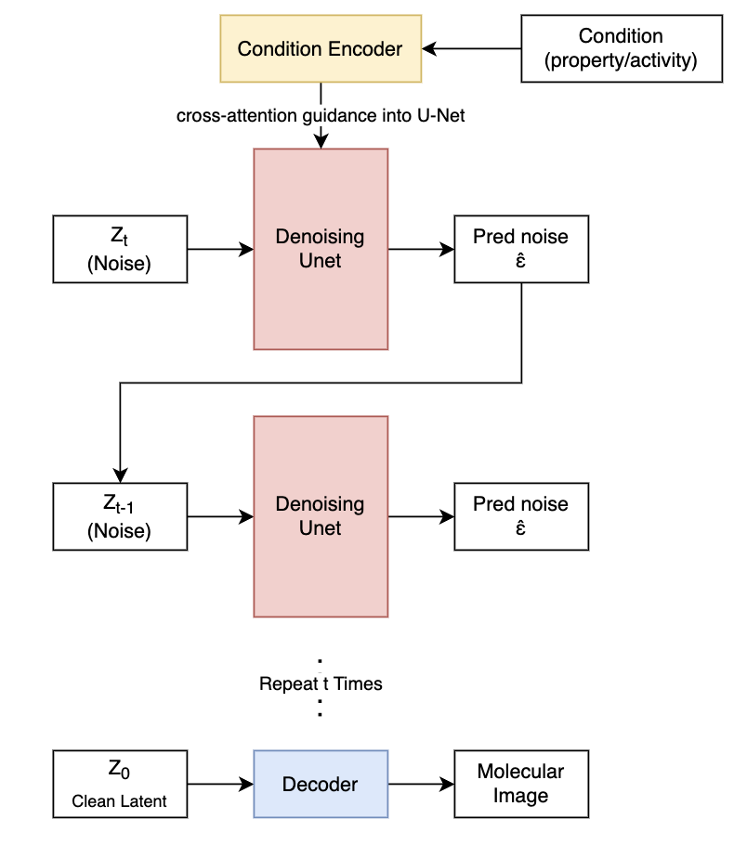
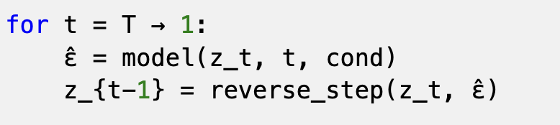
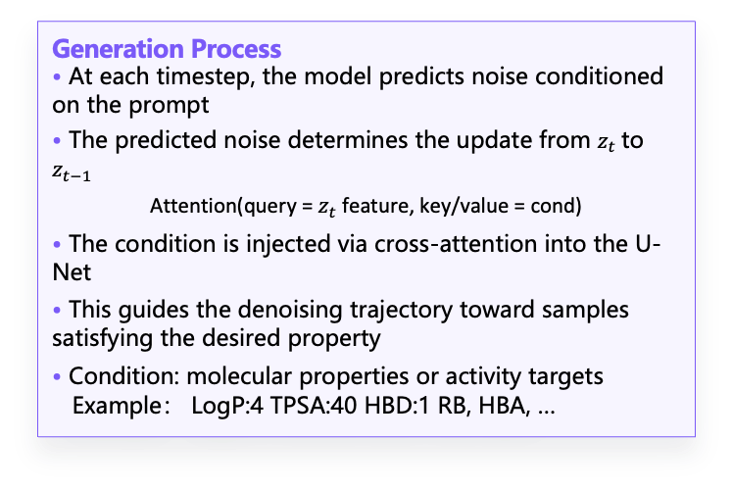
Conditional Sampling via Guided Denoising
Generation Process
• At each timestep, the model predicts noise conditioned on the prompt
• The predicted noise determines the update from $z_{t}$to $z_{t−1}$
Attention(query = $z_{t}$feature, key/value = cond)
• The condition is injected via cross-attention into the U-Net
• This guides the denoising trajectory toward samples satisfying the desired property
• Condition: molecular properties or activity targets Example： LogP:4 TPSA:40 HBD:1 RB, HBA, …
Next Slide: Editing
Notes:
Before, the model just generates any molecule.
But now, we want to control what kind of molecule we get.
For example, we may want:
certain properties or certain activity
So how do we do this?
We add a condition.
This condition can include things like:
logP
QED
or other properties
Then, we encode the condition into a vector representation.
This vector is injected into the U-Net through cross-attention layers.
In this way, the condition is integrated into the denoising process.
At each step, the model not only predicts noise, but also adjusts its prediction based on the condition.
So the generation is guided toward the desired properties.
提问： What is the Conditional Encoder? It might be a MLP or a embedding layer
The conditional encoder maps condition values into embeddings

Slide 8
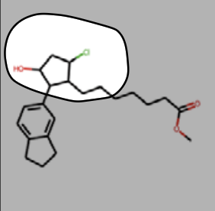
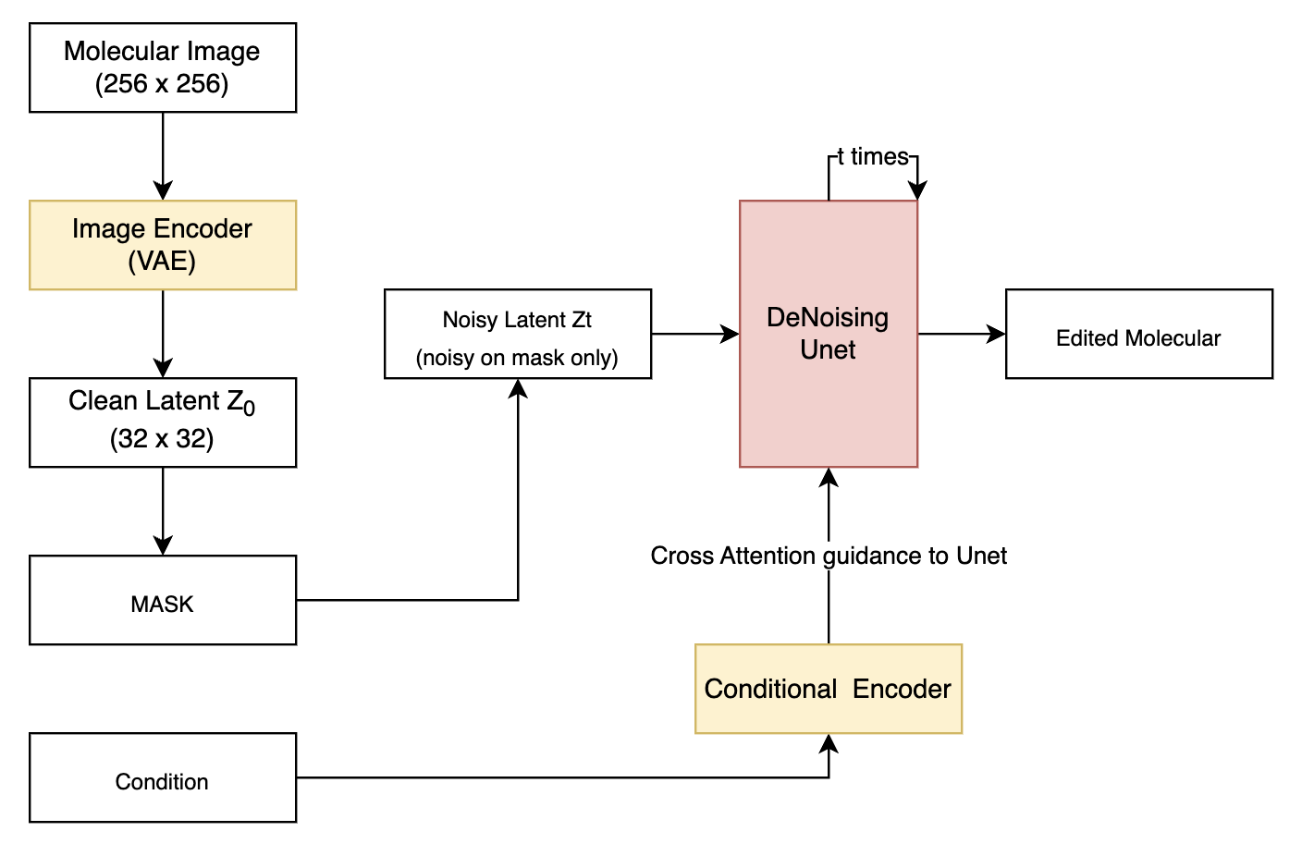
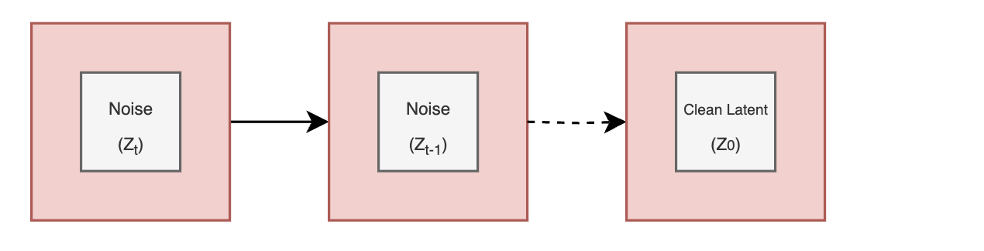
Inpainting for Local Molecule Editing
Molecule Editing Process • A mask specifies the region to be modified • Noise is applied to the masked region while preserving the rest • At each step, the model predicts noise conditioned on the target property • The unmasked region is reset to the original latent to preserve structure • The masked region is gradually generated via diffusion • Enables local editing while maintaining global consistency
Notes:
Now, let’s look at local molecule editing, using inpainting.
The idea is simple:
we do not change the whole molecule, we only modify a specific region.
First, we take a molecular image, and encode it into a latent representation.
Then, we define a mask.
This mask tells the model which part we want to change.
Next, we add noise only to the masked region.
The rest of the molecule remains unchanged.
Then, we run the diffusion process.
At each step:
the model predicts noise
and updates the masked region
At the same time, the unmasked region is reset to the original latent, so the overall structure is preserved.
We can also add conditions, so the edited part follows desired properties.
After several steps, the masked region is filled in, and we get an edited molecule.

Slide 9
RLME(Reinforcement Learning from Molecular Expert)
Core Motivation
In molecular image generation, realism is not enough. A generated image must also preserve chemically meaningful structure, such as readable atoms, valid connectivity, and plausible bonding patterns. This makes molecular generation a stricter problem than ordinary natural-image synthesis
Failure Modes of Naive Generation
• Diffusion models may produce images that look plausible at a glance but do not correspond to valid molecular structures.
• Because molecular images are sparse and highly structured, small visual errors can destroy chemical meaning.
• Typical problems include blurry or low-quality depictions, unreadable atom or bond layouts, and irrational bonding patterns.
• A visually smooth sample can still fail downstream molecular interpretation or expert validation.
Notes:
Now, let’s talk about RLME, which stands for Reinforcement Learning from Molecular Expert.
First, what is the problem?
In molecule generation, looking correct is not enough.
A generated molecule must be:
chemically valid
readable
and have correct bonding
But diffusion models have a problem.
They can generate images that look good at first glance, but are actually not valid molecules.
For example:
atoms may be unclear
bonds may be wrong
structure may not make sense
And here is the key point:
molecular images are very sensitive.
Even a small visual error can break the chemical meaning.
So even if the image looks smooth, it may still fail when we try to convert it back to a real molecule.

Slide 10
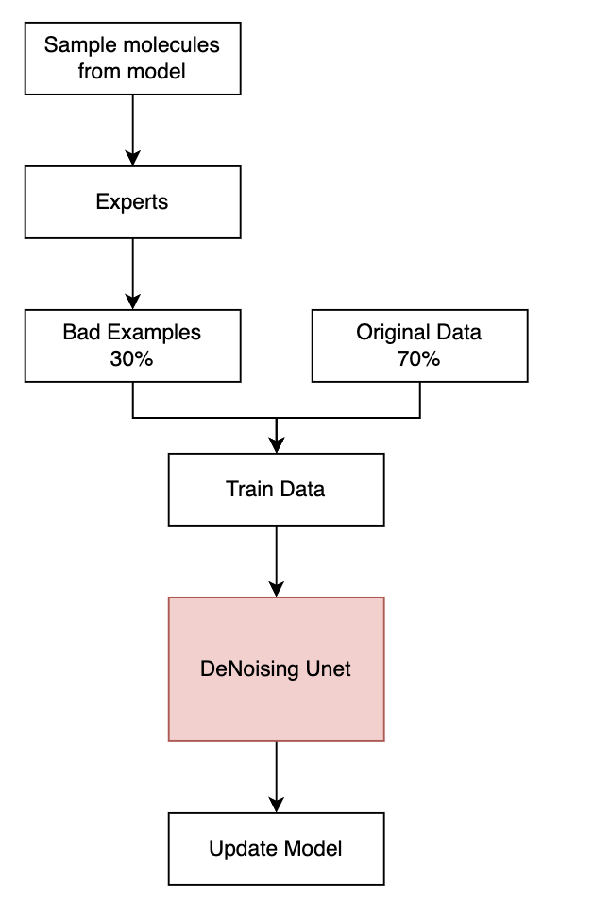
RLME (Fine Turn after Training Stage)
Core Idea • Generated molecules are evaluated by expert models (oracles) • Experts assign rewards based on desired properties • The model is optimized to generate higher-reward molecules
What is an Expert?
• External evaluation function (not part of the model) • Examples: – Property predictors (QED, LogP, etc.) – Chemical validity checks (RDKit)
Model Update
• Step 1: sample molecular images from current model
• Step 2: evaluate generated images with molecular experts • Step 3: build augmented feedback dataset (paper says problematic images are about 5% of training set size)
• Step 4: fine-tune the model using mixed training data (original data + expert-identified bad cases, e.g., 70% / 30%)
Notes:
This slide shows the RLME process, which is applied after the initial training stage.
The core idea is to introduce expert feedback to correct undesirable generations.
We first sample molecules from the current model, and then evaluate them using external experts, such as property predictors or chemical validity checks like RDKit.
These experts are not part of the model, but act as evaluation functions to identify wrong outputs.
The key step is that we collect these bad examples and mix them back into the training data.
Typically, about 30% of the training data comes from the bad cases, while 70% remains original data.
However, by modifying the training distribution, the model learns not only what to generate, but also what to avoid. (Because the bad examples will have larger loss)
模型学的是： “如果我走到了一个奇怪状态，我应该怎么修正”

Slide 11
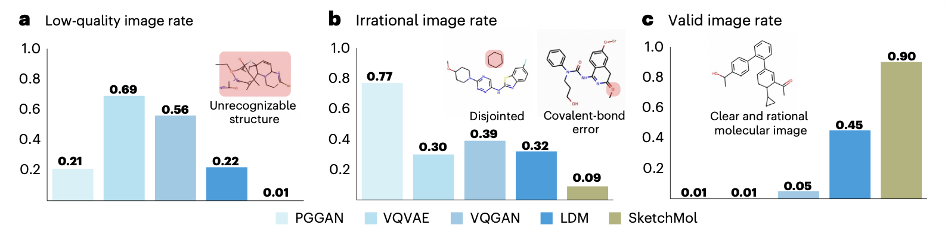
Quantitative Evaluation of Generated Molecules
• SketchMol significantly reduces low-quality generations • Dramatically lowers irrational molecular structures • Achieves the highest valid image rate (0.90)
• Prior methods often generate unrecognizable or chemically invalid structures • SketchMol produces clear, chemically consistent molecules
Notes:
Now, let’s look at the results.
This slide shows the evaluation.
There are three plots here:
First, low-quality image rate.
Lower is better.
We can see SketchMol is very low, around 0.01,
which means it produces fewer bad images.
Second, irrational image rate.
This means chemically incorrect structures.
Again, SketchMol is much lower than other methods.
Third, valid image rate.
Here, higher is better.
SketchMol achieves about 0.90,
which is much higher than others.
So overall,
SketchMol:
reduces low-quality results
reduces invalid structures
and generates more valid molecules

Slide 12
Conclusion & Future Directions
Main Contribution
Key Strength
• Proposes a unified visual-based molecular generation framework • Reformulates molecule design as image generation and editing • Integrates conditional control for property and activity guidance • Improves generation quality in both validity and interpretability
• Unified design for generation, editing, and inpainting • Intuitive image-based interface for molecule manipulation • Strong improvement in structural validity and chemical consistency • Flexible conditioning for multi-objective control
Limitations
• Limited expressiveness of 2D representations, lacking 3D geometry and stereochemistry • Reliance on OCR-based back-translation (e.g., MolScribe), introducing additional errors • Performance degrades for high molecular weight or complex structures
Notes:
Finally, let’s summarize the paper.
First, the main contribution.
This paper proposes a unified framework for molecule generation.
It treats molecules as images, and supports both generation and editing.
It also allows conditional control, so we can guide the model based on properties or activity.
Next, the key strengths.
It uses one framework for generation, editing, and inpainting
The image-based interface is more intuitive
It improves chemical validity
And it supports flexible control
Finally, the limitations.
It only uses 2D images, so it cannot capture 3D structure
It depends on OCR to convert images back to molecules
And performance drops for complex molecules

